Slide 1
Elicitation tool miro
Group
Bsef23m037- Fareeha Azhar
bsef23m046-Zuha Faiz
Bsef23m040-Abeeha Tariq

Slide 2
Introduction
Miro is an online collaborative whiteboard platform designed for brainstorming, planning, and visualizing ideas. It’s highly effective for elicitation activities in software requirements engineering due to its flexibility, real-time collaboration features, and templates designed for techniques like card sorting,surveys,class diagram etc.

Slide 3
How to Make a Board
Go to Miro DashBoard and log in or create an account.
Click "New Board", name it, and select a blank or template-based board.

Slide 4
Use Templates
Access templates via the "Templates" button.
Choose and customize templates for your elicitation activity (e.g., Card Sorting).

Slide 5
Collaborate with Teams
Invite teammates using the "Share" button.
Edit, comment, and communicate in real time.

Slide 6
Save and Export
Boards auto-save.
Export as PDF, PNG, or shareable links.

Slide 7
Version Control
Use Board History to track and restore changes.

Slide 8
Pros and Cons
Pros: Real-time collaboration, templates, user-friendly interface.
Cons: Performance issues on large boards, internet-dependent, costs for advanced features.

Slide 9
Guidelines
Define goals, keep boards organized, use color codes, and engage stakeholders.
Review and save/export progress regularly.
Here are some techniques we manage this via miro:

Slide 10
Card sorting
Card sorting is a technique used to understand how users group and categorize information. In Miro, you can use this technique to organize features or content related to a specific project or repository, like the Easy Digital Downloads (EDD) plugin from GitHub.Like here in pdf: card sort pdf
On miro:
Card Sorting

Slide 11
Survey and brainstorming
A survey is a method of collecting data or feedback from a group of people to gain insights, opinions, or information on a specific topic. Surveys are often used in research, marketing, education, and organizational settings.
We can collect feedback by using different stickers and templates.
Sprint planning

Slide 12
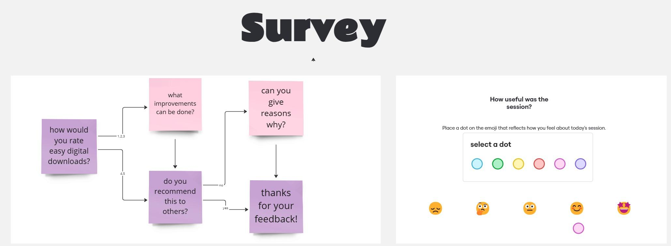

Slide 13
Brainstorming
Brainstorming is a creative group or individual activity designed to generate ideas, solutions, or insights. It encourages open-ended, free-thinking processes without judgment during idea generation.
We can add different templates and stickers for brainstorming and reverse brainstorming

Slide 14
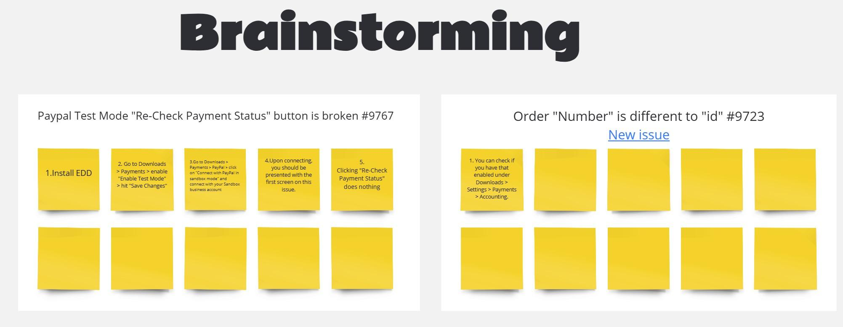

Slide 15
Interviews
The interview technique is a method used to gather insights, opinions, and feedback directly from stakeholders or end-users. It involves questions to uncover user needs and expectations.
Using Miro, interviews can be visualized by:
Collecting responses with sticky notes.
Prioritizing feedback using voting tools.
In the Easy Digital Downloads (EDD) GitHub repository, interviews can gather feedback from users and contributors about features, usability issues, or bug reports.

Slide 16
Questionnaire
The questionnaire technique is a method of gathering feedback from a group of stakeholders or users. This technique helps collect opinions, preferences, and requirements from many people quickly and efficiently.
Using Miro to conduct questionnaires makes the feedback process simpler.
In the Easy Digital Downloads (EDD) GitHub repository, a questionnaire could ask users and contributors about their experience with the desired new features, or other improvements.
This is the Pdf of interview and questionnaire technique:
Interview and questionnaire Elicitation Technique.pdf

